Slide 1
Every Trait Matters!
How life-history traits may affect the annual reproductive output in Amniotes (birds, mammals, reptiles)

Slide 2
Background
Reproductive rate is important and relative for conservation efforts
Lots of research done on traits affecting reproductive rate
Latitude, seasonality, size
Focus on a specific aspect of reproductive rate
Studies usually done at a species level
Still a lot unknown
Understanding important traits can identify species more at risk
Low reproductive rate correlated with sensitivity to habitat loss
Currently IUCN defines species risk solely based on population decline

Slide 3
Background
H₀: Reproductive output, in this case the average offspring produced per year, has no correlation with developmental traits (time to maturity, weaning time, incubation time etc.)
H_{A}: Reproductive output correlates with developmental traits
Predictions:
H₀ will be rejected
Traits related to development will be negatively correlated with reproductive output across all classes
Traits suggest high investment, few offspring life history strategy

Slide 4
Methods_Dataset
Name of the Dataset: An amniote life-history database to perform comparative analyses with birds, mammals, and reptiles.
Author of the database: N.P. Myhrvold, E. Baldridage, B. Chan, D.Sivam, D.L. Freeman, S.K. Morgan-Ernest.
Source of the data: Ecology, Vol 96, issue 11. November 2015. Published by the ESA.
Description of the data: this dataset contains 29 different life-history traits across 3 classes of amniotic organisms (birds, mammals and reptiles), including 72 orders, total of 21322 species.

Slide 5
Methods_Data Manipulation
We selected variables without obvious correlations with other variables from the dataset. (eg. adult body mass vs. female/male body mass, egg mass vs. egg length/width)
We filtered out all selected variables that contain NAs (in this dataset, -999) while try to maintain a relatively large sample size.
We calculated the average offspring produced per year by multiplying litter or clutch size with liter or clutch per year.
After all the manipulation, we ended up with
206 sampled species with 9 variables in Aves
152 sampled species with 10 variables in Mammalia
32 sampled species with 8 variables in Reptilia

Slide 6
Methods_Analyses
First we performed correlation test to all three classes to see if there exists any relationships among our variables
Then we performed PCA (Principal Component Analysis) to all three classes.
Then we removed some of the variables from each class that are highly correlated with other variables and performed another set of PCAs to three classes

Slide 7
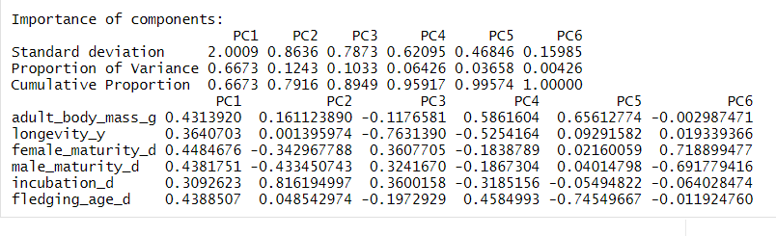
Results (Aves)
Table1. The result of Aves PCA. The combination of PC1 and PC2 explain 79.2% of variances. All six traits equally contributed to the PC1 and are all positively correlated. Incubation time contributed the most to the PC2 and are in a opposite relationship with time to maturity.

Slide 8
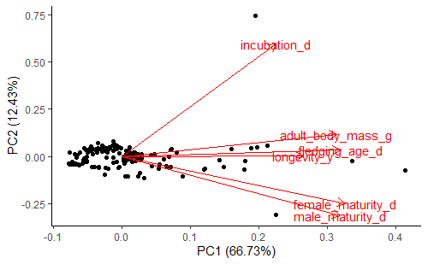
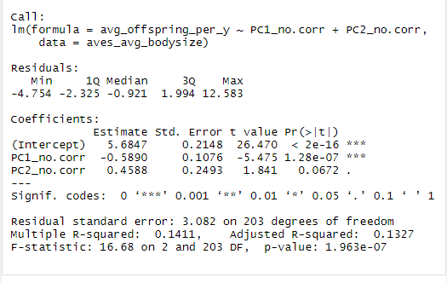
Results(Aves)
Fig1. The Autoplot of Aves class PCA. Each black dot represents an bird species, and red arrows represent the loadings of each traits. Based on the plot, the body mass, fledgling age, longevity, time to maturity are more correlated to PC1, and incubation time is more correlated to PC2
Table2. PC1 has a significant impact on the average offspring produced per year, and PC2 has a weak and insignificant impact on the average offspring produced per year.

Slide 9
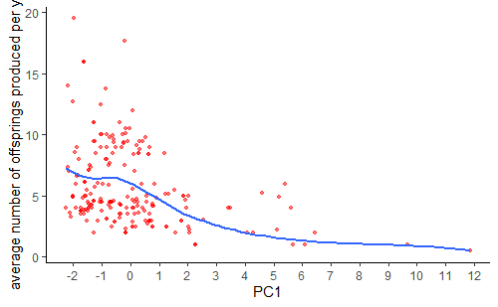
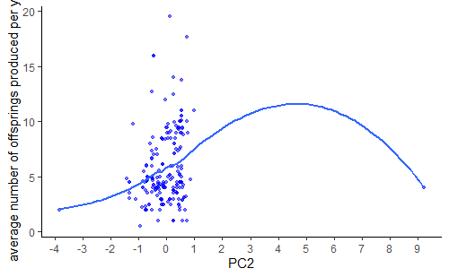
Results(Aves)
Fig 2. This plot shows how PC1 affecting annual reproduction output of bird species. Each point represents a bird species.It’s clear that there exists a negative relationship between PC1 and annual reproduction output, with PC1 value gets bigger the offsprings produced declines.
Fig 3. This plot shows how PC2 affecting annual reproduction output bird species. Each blue point represents a bird species. Based on the plot, PC2 has a relatively limited impact on annual reproduction output because most dots concentrate in a small region.

Slide 10
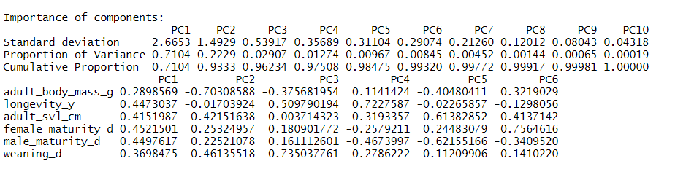
Results(Mammalia)
Table 3. The result of the Mammalia PCA. The combination of PC1 and PC2 explain 93.3 % of variances. Longevity, adult svl, female and male time to maturity contribute the most to the PC1 and are all positively correlated. Adult body mass contributed the most to the PC2 and are in a opposite relationship with time to maturity and weaning time.

Slide 11
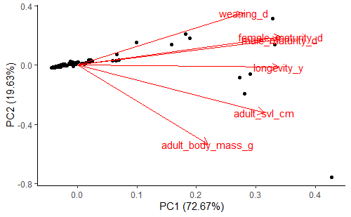
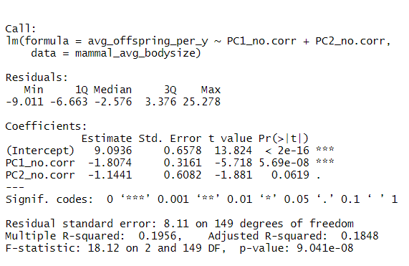
Results (Mammalia)
Fig 4. The Autoplot of Mammalia class PCA. Each black dot represents an mammal species, and red arrows represent the loadings of each traits. Based on the plot, svl, longevity, time to maturity are more correlated to PC1, and adult body mass and weaning time more correlated to PC2
Table 4. PC1 has a significant impact on the average offspring produced per year, and PC2 has a weak and insignificant impact on the average offspring produced per year.

Slide 12
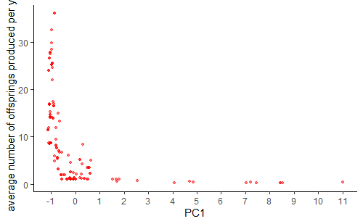
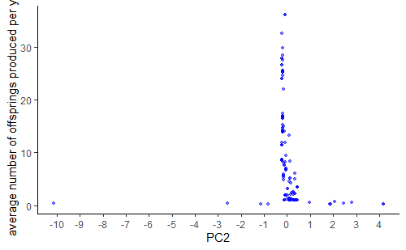
Results_Mammalia
Fig 5. This plot shows how PC1 affecting annual reproduction output of mammal species. Each red dot represents a mammal species. It’s clear that there exist a negative relationship between PC1 and annual offsprings number, as the PC1 value increase, the number of offsprings produced per year declines.
Fig 6. This plot shows how PC2 affecting annual reproduction output of mammal species. Each blue point represents a mammal species. Based on the plot, PC2 has a relatively limited impact on annual reproduction output because most dots concentrate in a small region.

Slide 13
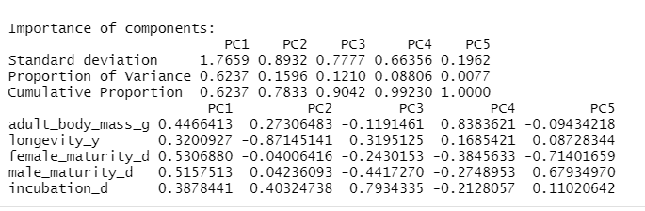
Results (Reptilia)
Table 5. The result of the Reptilia PCA. The combination of PC1 and PC2 explain 78.3% of variances. The female and male time to maturity contribute the most to the PC1 with a positive correlation, but note that other three traits also contribute a fair amount to PC1. Longevity alone contribute the most to the PC2.

Slide 14
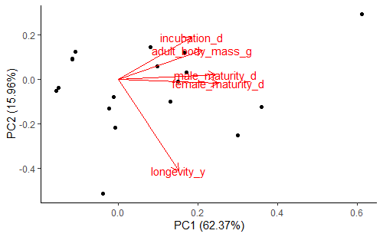
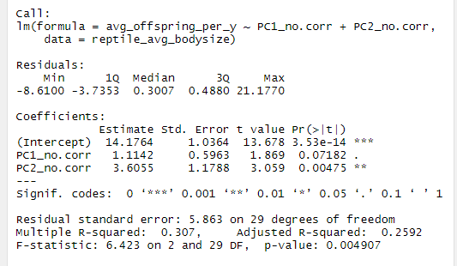
Results_Reptilia
Fig 7. The Autoplot of Reptilia class PCA. Each black dot represents an reptile species, and red arrows represent the loadings of each traits. The plot shows that incubation time, adult body mass and time to maturity are more correlated to PC1, and longevity correlates more to PC2.
Table 6. PC1 has a weak and insignificant impact on the average offspring produced per year, and PC2 has a significant impact on the average offspring produced per year.

Slide 15
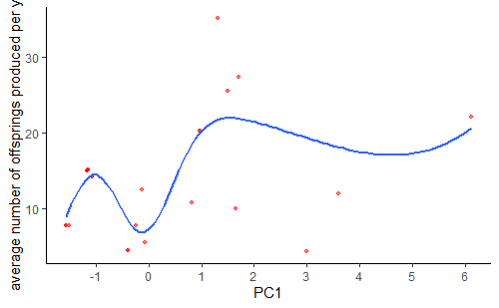
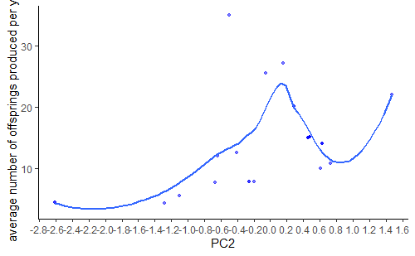
Results_Reptilia
Fig 8. This plot shows how PC1 affecting annual reproduction output of reptile species. Each red dot represents a reptile species. The plot shows there is a positive relationship between PC1 and annual reproductive output in reptile species, but the relationship seems to be irregular. This irregular relationship may because of the smaller sample size.
Fig 9. This plot shows how PC2 affecting annual reproduction output of reptile species. Each blue dot represents a reptile species. The plot shows there is a positive relationship between PC1 and annual reproductive output in reptile species, but the relationship seems to be irregular. This irregular relationship may because of the smaller sample size.

Slide 16
Discussion
Trait | Aves | Mammals | Reptiles
Adult Body Mass | Negative | Negative | None
Longevity | Negative | Negative | Positive
Female Maturity | Negative | Negative | None
Male Maturity | Negative | Negative | None
Incubation | Negative | N/A | None
Fledging Age | Negative | N/A | N/A
Adult SVL | N/A | Negative | N/A
Weaning | N/A | Negative | N/A
PC1 negatively correlated with the reproductive rate in mammals and birds
All variables contribute positively to PC1 and therefore negatively correlated to the reproductive rate
PC2 is not as significant of a predictor
PC2 positively correlated with the reproductive rate in reptiles
Longevity contributes negatively to PC2 and therefore negatively correlated to the reproductive rate
Other variables contribute little to nothing to PC2
PC1 is not as significant of a predictor
Results are as expected
Based on life history strategies
Species with very large values for variables negatively correlated with reproductive rate are more sensitive to habitat loss
Better Identify which species are at risk

Slide 17
Limitations
The analysis of the Reptilia group has a relatively small sample size. After data manipulation, we only had 32 reptile species available for further studies, which is relatively small compared to the other two taxa groups (206 for Aves and 152 for Mammalia). This may affect the power of our analysis.
The dataset we used are based on information gathered from various sources(other database, articles, thesis etc.), and we have no idea how the data were measured in the field. This could lead to biased data on some species. Although these biases should be local and inconsistent across the dataset due to the size of the dataset, these problems may affect our analyses of some taxonomic groups without being noticed.

Slide 18
Disscussions_Future topics
Instead of looking at three major amniote groups separately, we could looking for shared traits, and trying to understand how same trait or same set of traits affect different taxa.
Due to the limitation of the data available, many traits were not tested. So it could be interesting to use a more complete dataset with more valid data.

